Slide 1

Python for ML

Slide 2
Introducing EPOCH CLUB
WHAT IS EPOCH ?
Epoch ML Club fosters learning and innovation in the fields of Artificial Intelligence and Machine Learning, providing a collaborative environment for students to build technical skills and engage in impactful projects
Our club focuses on Computer Vision, Natural Language Processing (NLP), Robotics, and MLOps, equipping members with cutting-edge tools and techniques to solve real-world problems

Slide 3
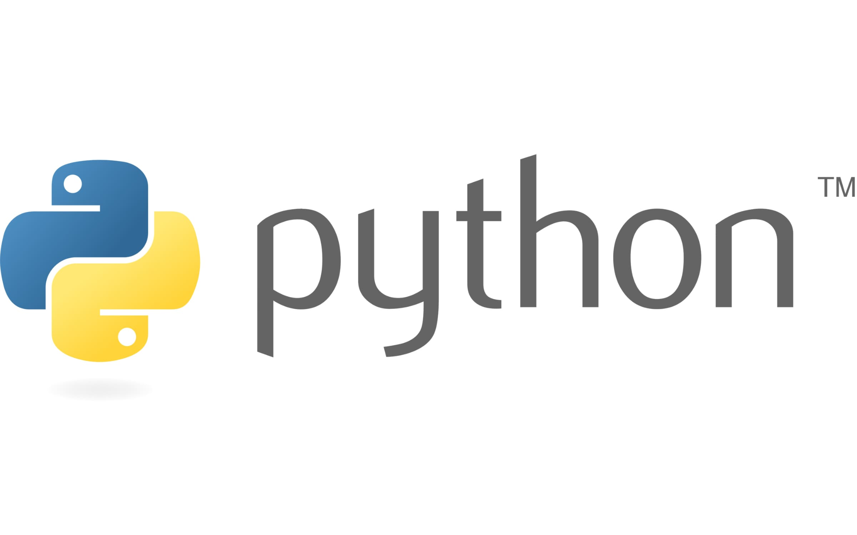
Revisited!

Slide 4
Python Basics - Revisited!
Data Types:
Strings
Lists
Dictionary
Tuples
Sets
Membership : The in and not in operator
Functions
Lambda Expressions

Slide 5
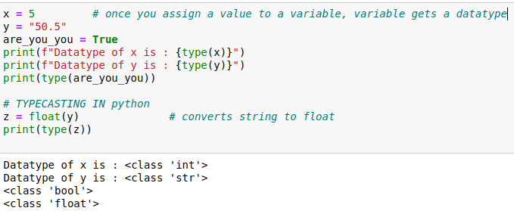
Variables and Datatypes
Python has no command for declaring a variable.
A variable is created the moment you first assign a value to it.

Slide 6
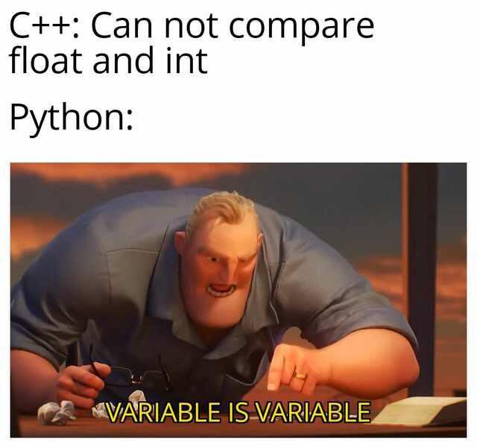
Python Vs C/C++? Well, who is better?

Slide 7
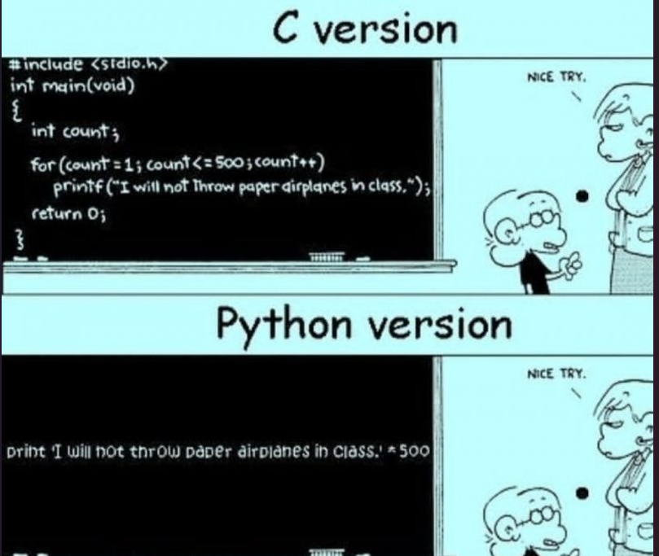
Python wins??? Wait, not yet!

Slide 8
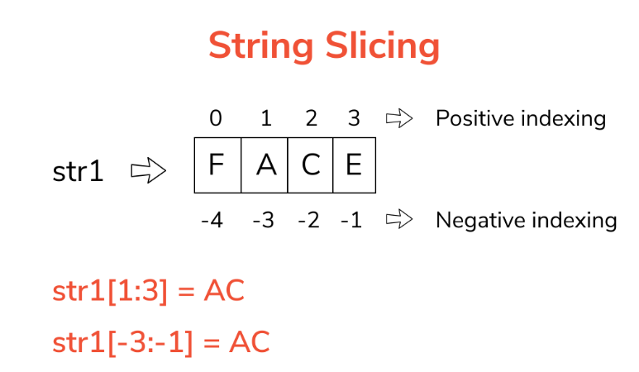
No strings attached!
Strings in python are surrounded by either single quotation marks, or double quotation marks.
Slicing: Return a range of characters by using the slice syntax.

Slide 9
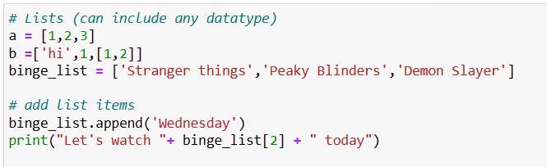
Lists = Arrays?
Lists are used to store multiple items in a single variable. Can include any datatype
Lists are created using square brackets:
Can you predict the output ?

Slide 10
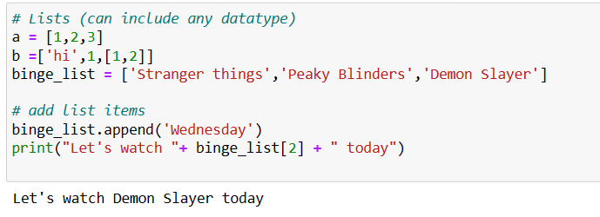
Ready for Binge Watching?
The output :-

Slide 11
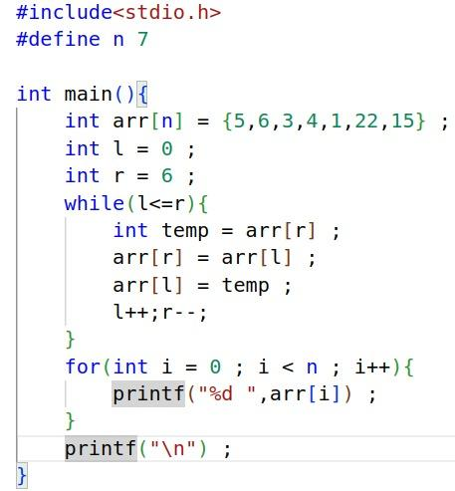
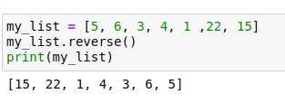
Lists in Python vs Arrays in C
Code for reversing an array
Lot of inbuilt methods in Python
Easy and concise compared to C

Slide 12
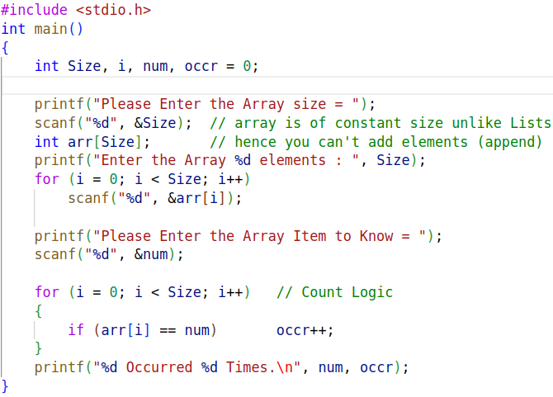
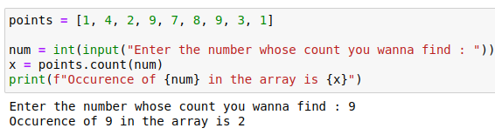
Python wins??? Wait, not yet! - Now, yes - Maybe?
A simple task for counting the number of of occurrence of a particular element in an array is so much longer in C than in Python !
Look it for yourself !

Slide 13
Inbuilt Functions in Lists
Due to the popularity of lists, it has a lot of in-built methods (which you can explore ) listed as
append() Adds an element at the end of the list
copy() Returns a copy of the list
count() Returns the number of elements with the specified value
index() Returns the index of the first element with the specified value
insert() Adds an element at the specified position
pop() Removes the element at the specified position
remove() Removes the item with the specified value
reverse() Reverses the order of the list
sort() Sorts the list

Slide 14
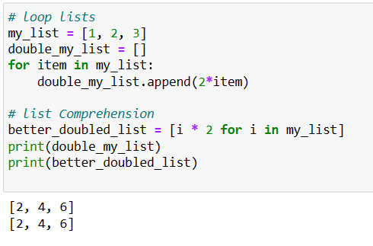
List Comprehension
Use list comprehension when you want to create a new list based on the values of an existing list.
It offers shorter syntax compared to using for loops to create a new list

Slide 15
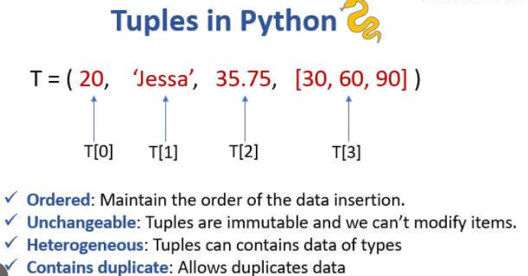
Tuples
A tuple is a collection which is ordered and immutable(unchangeable)
Tuples are fixed size in nature whereas lists are dynamic. In other words, a tuple is immutable whereas a list is mutable.

Slide 16
More on Tuples
You can't add elements to a tuple. Tuples have no append method.
You can't remove elements from a tuple.
You can find elements in a tuple, since this doesn’t change the tuple.
Why tuples when there is lists ? Or when to use tuples?
Faster than lists. If you're defining a constant set of values and all you would do with it is iterate through it, use a tuple instead of a list.
Makes your code safer if you “write-protect” data that does not need to be changed. Using a tuple is like having an implied assert statement that this data is constant.
Tuples are like Jee Advanced Ranks, you can't change them ! Ok, but one paper can not decide my future 😉!

Slide 17
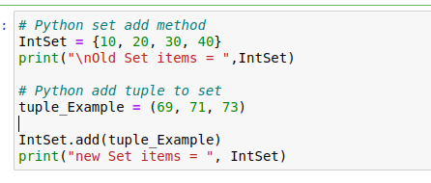
Sets - The one we see in Math? Yes!
Sets are defined by unique elements and are unordered
Note: Set items are unchangeable, but you can remove items and add new items.-
When to use a set : If you just need to know whether or not a value is present , but without ordering (and you don't need to store duplicates) Use a set.
What might be the Output ?

Slide 18
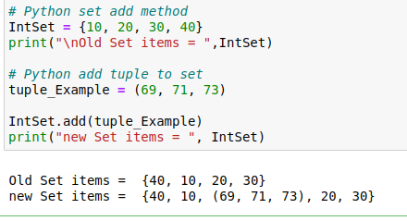
Example
Output:

Slide 19
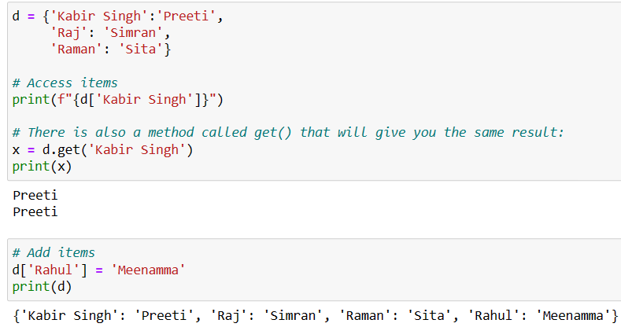
Dictionaries - Not the Oxford one!
used to store data values in {key:value} pairs.
is ordered , changeable and do not allow duplicates in the sense that you can not repeat keys.

Slide 20
Dictionaries >> Two Lists
You can also access items of a dictionary using its key name e.g d[‘Raj’]
Dictionaries can have any data type in the value
Each key must be immutable. Values maybe mutable.
This allows lists to be the values of a key. Lists cannot be keys.
Why not two lists but a dict?
Easier and faster because it uses key - value mapping format, something 2 lists being used parallely can’t.

Slide 21
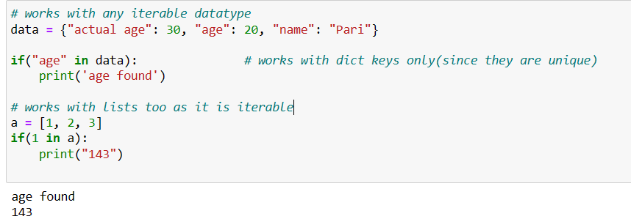
The ‘in’ and "not in" Operator in Python
The in keyword can also be used to check if a value is present in a sequence (list, range, string etc.).

Slide 22
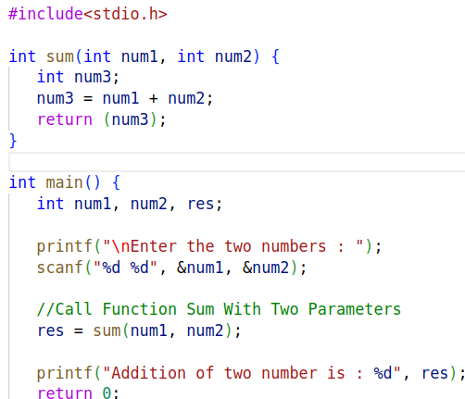
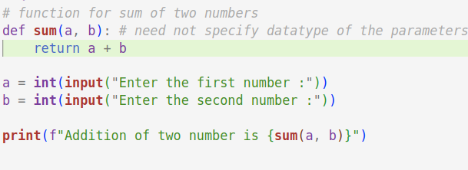
Functions in Python vs C
A simple code for adding 2 numbers
Lots of line in C
Simplified in Python

Slide 23
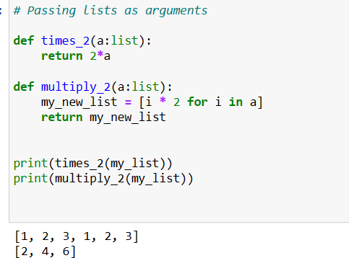
Lists as argument to function!
-
Note that multiplying a list with a number k will repeat the items of the list as the size of the number k

Slide 24
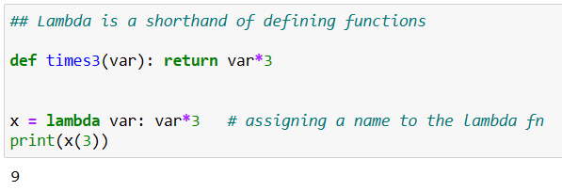
λ - expressions!
Syntax: lambda arguments : expression

Slide 25

Intro to

Slide 26
Numpy Vs Lists
What is numpy?
NumPy is a Python library used for working with arrays.
Various functions of linear algebra, fourier transform, and matrices make numpy arrays a powerful tool.
Example: my_numpy_array = [1,2,3]
What is a list?
A Python list is a collection that is ordered and changeable.
Example: Var = ["Epoch", "IIT", "Hyderabad"]

Slide 27
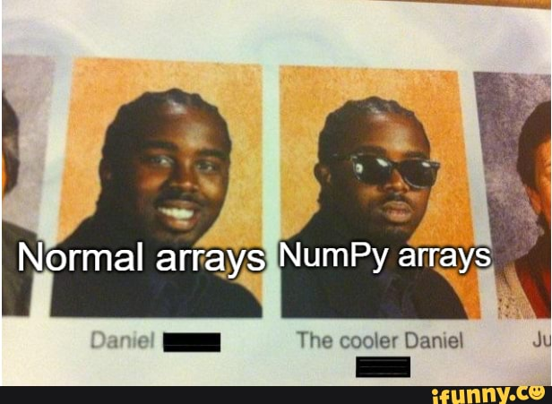
NumPy Arrays vs Normal Arrays - Is comparison even needed?

Slide 28
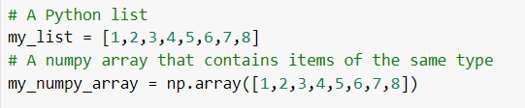
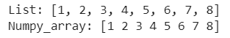
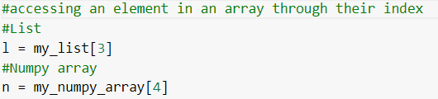
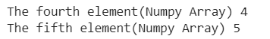
NumPy Operations = Superset of List Operations
Initialization:
Accessing the items through index:

Slide 29
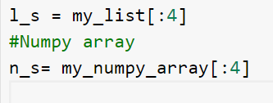
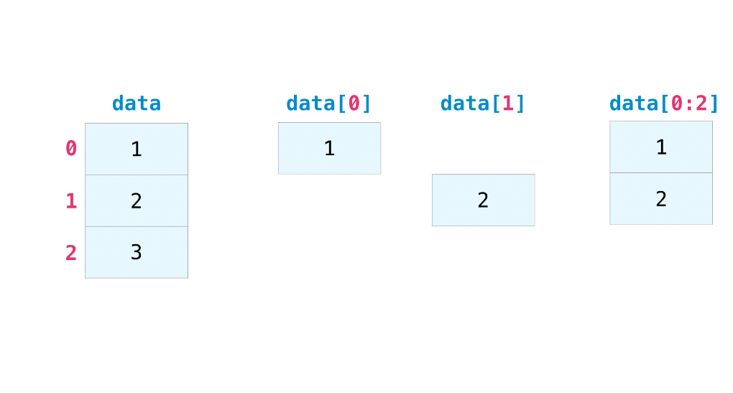
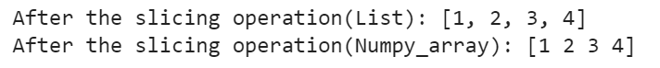
Slicing again…you ready now?

Slide 30
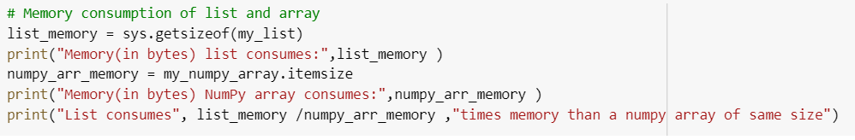
NumPy vs Lists - Faceoff: Memory Comparison
Memory(in bytes) list consumes: 120
Memory(in bytes) NumPy array consumes: 8
List consumes 15.0 times memory than a numpy array of same size

Slide 31
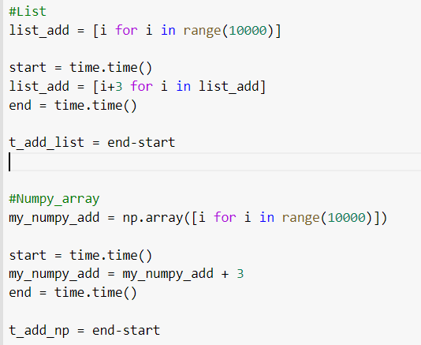
NumPy vs Lists - Faceoff: Time Comparison
Code
Text
List after adding 3: [3, 4, 5, 6, 7]
Numpy after adding 3: [3 4 5 6 7]
Comparing the time consumed by lists and numpy arrays for addition operation
Lists: 0.004734516143798828 Numpy_Array 0.0003457069396972656
Numpy arrays are 13 times faster

Slide 32
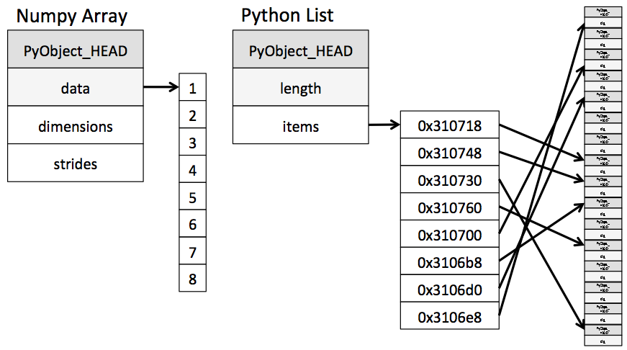
NumPy Arrays vs Lists: How are the represented internally?

Slide 33
NumPy Arrays are faster and memory efficient - Explained!
NumPy arrays, unlike lists, are kept in a single continuous location in memory, allowing programs to access and manipulate them quickly. Having them in contiguous memory locations helps reduce latencies in finding the next element and traversal is made faster this way!
Lists are internally implemented using the Linked List Data Structure. In order to store the pointers for addresses of the previous and next elements in the list, some extra memory is taken. In NumPy, since they are allocated memory continuously, there is no need to have their pointers to point us to the address of the next locations.

Slide 34
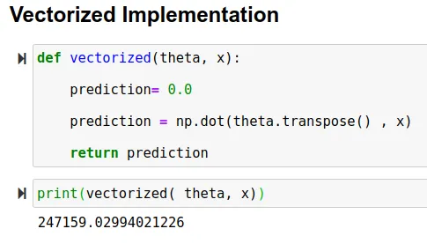
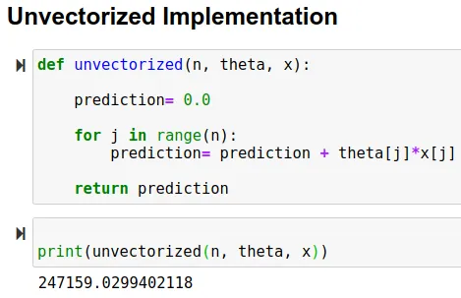
The Vectorization Hack!
Vectorization is the process of converting an algorithm from operating on a single value at a time to operating on a set of values at one time.
Advantages of Vectorized Implementation
Our code runs efficiently
Our code becomes simpler and easy to debug

Slide 35


Slide 36
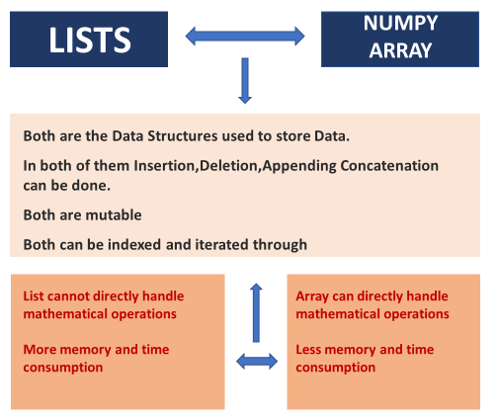
And that’s a wrap - Lists vs NumPy Arrays!

Slide 37
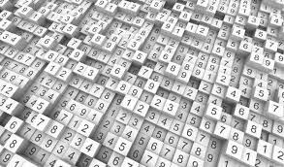
Random Number Generation

Slide 38
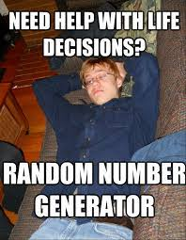

Slide 39
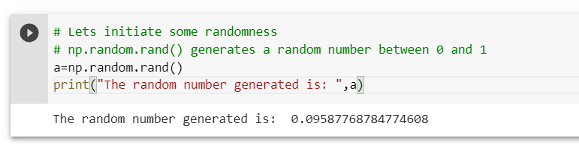
Random Numbers
Python defines a set of functions that are used to generate or manipulate random numbers through the random module.
np.random rand(shape)
It produce random values in a given shape from a uniform distribution.

Slide 40
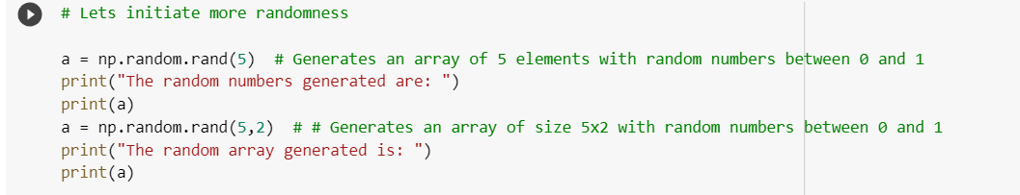
Random Arrays and Matrices
Let’s create NumPy array with random numbers

Slide 41
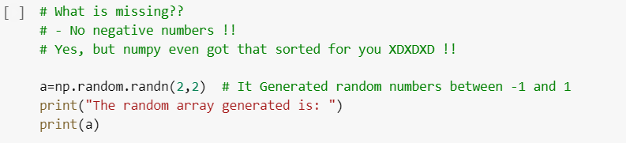
Can we generate negative random numbers too? Yes!
What if we want random negative numbers too?
np.random.randn(shape)
Returns random numbers sample from a “standard normal” distribution.

Slide 42
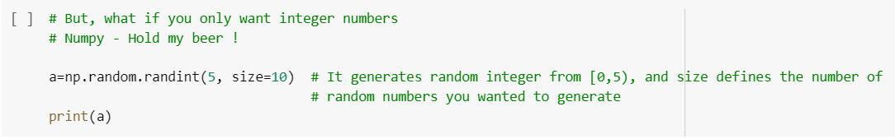
Random Integers
All the above method generates random floating point numbers, but what if you want random integers.
np.random.randint(low, high=None, size=None, dtype=int)
Low = 0 (default)

Slide 43

The G.O.A.T Debate! - Messi vs Ronaldo

Slide 44
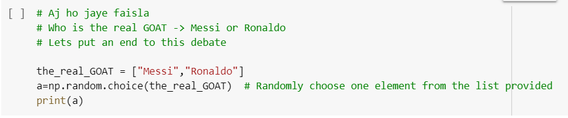
NumPy’s say on the G.O.A.T Debate :)
Let’s see what numpy has to say about!!
np.random.choice(a, size=None, replace=True, p=None)

Slide 45

The G.O.A.T Debate! - Messi vs Ronaldo No Intro Needed now!!

Slide 46
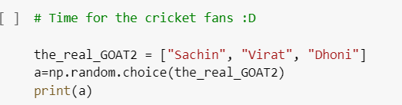
NumPy’s say on the G.O.A.T Debate :)
Let’s see what NumPy has to say about it:

Slide 47
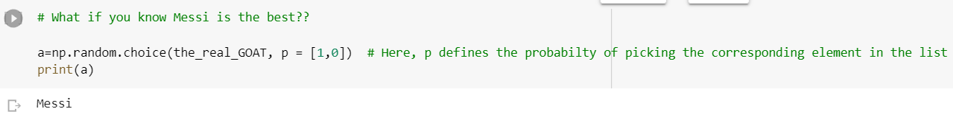
Messi Fans - This is for you!
Let’s cheat the system
The parameter p defines the probabilities associated with each entry in a. If not given, the sample assumes a uniform distribution over all entries in a.

Slide 48
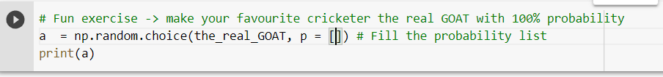
Cricket Fans - It’s your turn now :)
Quick Exercise !!
Make your favourite cricketer win the game 😉
Fill the “p” parameter to make the event certain

Slide 49
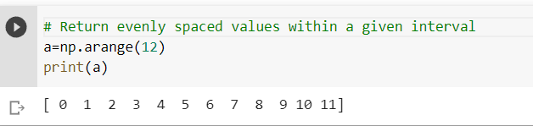
np.arange
Let’s generate some organized numbers now
np.arange(start, stop, step):
allows you to define the step size and infers the number of steps(the number of values you get)

Slide 50
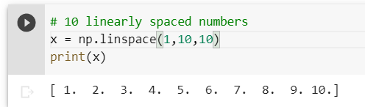
np.linspace
np.linspace(start, stop, num)
It allows you to define how many values you get including the specified min and max value
How it is different from np.arange()?
You do not need to specify the step size in np.linspace. It calculates the step size according to the number of points you want.

Slide 51
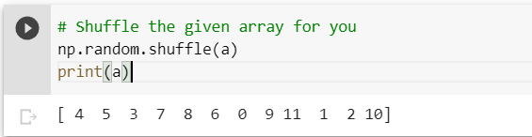
np.shuffle: Nah, not the Dance Club :-|
np.shuffle(x)
Modify a sequence in-place by shuffling its contents.
From shuffling our spotify playlist to shuffling our arrays, we have came a long way.

Slide 52
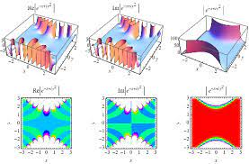
Probability Distributions

Slide 53
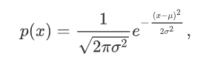

Probability Distributions: Gaussian Distribution
Gaussian/Normal distribution
- The probability density for the Gaussian distribution is
Saw this in Modern Physics right? It’s not that scary as it looks!
The function has its peak at the mean, and its “spread” increases with the standard deviation. This implies that normal is more likely to return samples lying close to the mean, rather than those far away.

Slide 54

Random Sampling from Distributions
np.random.normal(loc = 0.0, scale = 1.0, size = None)
It generates random numbers from a normal distribution.
Here, loc is the mean of the distribution and scale = variance of the distribution.
Confusing?? Let’s plot it !!

Slide 55
Other Distributions!
There are still a lot of distributions that NumPy offers like:
np.random.weibull()
np.random.poisson()
np.random.binomial()
np.random.uniform()
etc.,
These are left for you to explore ! And stay tuned for the Math for ML session!

Slide 56


Intro to

Slide 57

Plotting - Let’s get started!
We use matplotlib for plotting figures in python.
Matplotlib is a comprehensive library for creating static, animated, and interactive visualizations in Python.
plt.hist(x,bins, density) : Plot the histogram of the data
plt.plot() : Plot the curve in the figure
We will see this in more details in the upcoming slides

Slide 58

Gaussian Distribution - The Bell Curve!

Slide 59

Cricketing Analyst - Tutorials!
Let’s plot some interesting data.
I extracted out the scores of Virat Kohli in the last 6 ODI innings. Let begin our journey to Cricket Analyst and plot the data.
plt.bar(x, height, width = 0.8, align = “center”) : Plots the bar graph of the data x
We generate the x using np.linspace and Virat score is the height of our bars.

Slide 60

Plotting - Important Functions
plt.title()
gives a title to the graph
plt.xlabel()
gives a label to the x-axis
plt.ylabel()
gives a label to the y-axis

Slide 61

The plt.plot() function!
plt.plot(x, y, color, marker, linestyle, linewidth, label)
Plot y versus x as lines
Color - To specify a colour to our line plot
Linestyle - To customize our line
Linewidth - To customize our line width
Label - To label our line

Slide 62

plt.grid()
plt.grid() - Plots the gridlines in the graph

Slide 63

Can we plot multiple plots in a single figure? Yes!
Multiple plots in a single figure

Slide 64

plt.legend(): Yeah Virat is a legend, but this is different!
plt.legend() - Plots the legend box in the figure

Slide 65

Upcoming Legend? Tendulkar?? Sara Shubman Gill
Exercise Time! Plot the bar graph of Shubman Gill’s scores

Slide 66

Scatter Plots!
plt.scatter(x, y, marker, color)
Plots the scatter plot of x v/s y with varying markers.

Slide 67

The Final Plot!

Slide 68


Functions and Gradients

Slide 69

Mathematical Functions - Wait, we gonna see Cal - 1? Absolutely not!
Mathematical functions in numpy are special because they can be used to perform operations element-wise on either python lists or numpy arrays.

Slide 70




Trig Functions!
.sin(), .cos(), .tan()
.arcsin(), .arccos(), .arctan()

Slide 71



Trigonometric functions
.sinh(), .cosh(), .tanh()
.degree(), .radian()

Slide 72


Logarithmic functions
.log(), .log2(), .log10()
.exp(), .exp2()

Slide 73


Additional functions
.around(), .floor(), .ceil()
.mod(a,b)
Modulo function, prints remainder of elements in a with those in b element wise.

Slide 74


.max(), .min()
The maximum/minimum element in an array.
.add(), .subtract(), .multiply(), .divide()
Add, subtract, multiply, or divide two numpy arrays element wise.

Slide 75


.conj(), .isreal()
.maximum, .minimum

Slide 76


A few interesting functions
.cbrt() - returns the cube root of a number.
It is one of the few ways in python that allows you to take the real cube root of a negative number - Most functions return the complex root instead.

Slide 77

.where()
Allows you to set your own conditions and returns result from the first array if true, else returns the value from the second array.

Slide 78


Gradients
np.gradient(fx,x) will output the approximate gradient calculated using numpy arrays of f(x) and x.

Slide 79


Since gradients are calculated mathematically, they do have inaccuracies - but thankfully, they are rather low.

Slide 80


Matrix Operations and Transformations

Slide 81

Matrices or Multi-Dimensional Arrays
Let's cover some basic functions to create numpy matrices
Matrices from 2D or 3D or ND Lists.
Ones, Zeros,and Identity.

Slide 82

Creating Matrices using NumPy array method
array() Method:
It takes a 2D or 3D or ND List and returns a Numpy Multidimensional Array or Matrix.

Slide 83



Creating Matrices using NumPy Functions
zeros():
Returns a Numpy Array of all zeros of given shape.
ones():
Returns a Numpy Array of all ones of given shape.
identity():
Returns a 2D Identity Square Matrix of given Rows, Columns.

Slide 84





Shape of np array
shape:
Returns the number of elements in each dimension of the np array.
ndim:
Returns the Number of Dimensions of the np array.

Slide 85

Reshaping np arrays
reshape():
Returns the reshaped np array if possible.

Slide 86

Matrix Transformations : Addition
Now we will look at a function to add two matrices:
add() method : Takes Two numpy matrices of same size and adds them.

Slide 87



C vs NumPy for matrix multiplication

Slide 88

Matrix Transformations : Multiplication
Now we will look at a function to multiply two matrices:
element wise matrix multiplication : Multiplies matrices element by element just as add() does

Slide 89

Matrix Multiplication - 1
matmul() method : Multiplies matrices just like you did in your JEE !

Slide 90


Matrix Multiplication - 2
Another way of multiplying : :::;matrices: @ operator

Slide 91

Matrix Transformations : Trace
trace() method takes np array as input and outputs its trace.

Slide 92

Matrix Transformations : Determinant
linalg.det() method takes np array as input and returns its determinant

Slide 93


Matrix Transformations : Transpose
T attribute returns a matrix which is the transpose of the given Matrix.

Slide 94

Matrix Transformations : Inverse
linalg.inv() method takes matrix as input and return a matrix which is its inverse

Slide 95

Matrix Transformation : Matrix Power
linalg.matrix_power() takes a matrix and an integer as input and returns matrix raised to the power integer.

Slide 96

Solving Linear Equation
Quick Exercise!
Given matrices A and B, can you calculate X such that AX = B using functions used so far ?

Slide 97

Solving A linear equation
Solving a linear equation can be cumbersome when the number of equations increases, numpy gets it done efficiently!

Slide 98


Matrix Transformations : Stacking
Stacking matrices in a new dimension has many uses. This can be implemented with the numpy stack() method

Slide 99
Other Functions
There are still a lot functionalities that NumPy offers like:
Important Statistical Functions:
mean(), median(), var()[For variance] ,std() [Standard Deviation]
Functions for expanding and squeezing dimensions:
squeeze(), expand_dims()
These are left for you to explore !!!

Slide 100


Fun Exercise
Alright! Now we have an exercise for you, implement what you've learnt, follow the instructions below and have fun.

Slide 101




Let’s Begin !
Task #1 Task #3
Task #2 Task #4

Slide 102

Look at what you just created!
After stacking the matrices that you guys created and displaying the image associated with it using plt.imshow(), this is what you get…..

Slide 103
Resources!
Python Documentation
NumPy Documentation
Matplotlib Documentation

Slide 104



Social Media - Epoch
Follow our social media handles for regular updates
Instagram
Linkedin
YouTube
WhatsApp

Slide 105
Any Questions or Suggestions?

Slide 106
Thank You!

